Slide 1


The Goldilocks Approach to Leadership:
Why There is No One Size Fits All Solution
Presented by: Drew Lewis (he/him/his)
Client Development Specialist

Slide 2


Today’s Agenda
01. Leadership Styles Overview
02. Transformational Leadership
03. Authoritarian Leadership
04. Servant Leadership
05. Democratic Leadership
06. Transactional Leadership
07. Delegative Leadership
08. Pacesetting Leadership
09. Crafting Your Own Style
Notes:
Today we are going to be taking about 7 of the most popular leadership styles. We will be talking about the foundations of each style along with pros and cons in terms of the style itself and in what environments each style would be well or poorly suited.
After talking about each of these leadership styles we’ll talk about how to create the best leadership style for you, your team, and your organization.
https://www.imd.org/imd-reflections/reflection-page/leadership-styles/#2
https://blog.hubspot.com/marketing/leadership-styles
https://www.indeed.com/career-advice/career-development/10-common-leadership-styles
https://asana.com/resources/leadership-styles

Slide 3
Leadership Styles Overview

Slide 4

What Are Leadership Styles?
  Different ways to provide direction
  to your team or organization.
  There is no best leadership style
  for every situation.
  Different teams and different organizations, need different
  kinds of leadership.
Notes:
If we take a moment and ask ourselves, what is leadership, or what makes a good leader we would all likely come up with a different answer. I like the thought on this quote that makes you fill in the blank for what a great leader should always do, your answer likely says a lot about your leadership style.
At its core, a leadership style is the culmination of all the decisions you make when deciding how to best lead your team or organization. As the title of today’s webinar would lead you to believe, there is not a one size fits all answer for the definitive best leadership style. Different teams and different organizations will all need different kinds of leadership to excel, and to break it down to an even more micro level, different individual employees will each need different leaders to excel; and finally, organizations may need different kinds of leaders at different points in time. You may only need a transformational leader for a few years before shifting to a different kind of leadership in order to continue succeeding.

Slide 5
Transformational Leadership

Slide 6


Transformational
Leadership Overview
01.
02.
03.
Sometimes referred to as a visionary leader.
Inspires their team with a grand vision and then encourages and empowers them to achieve it.
Part of this process is the leader pushing employees outside of their comfort zones to help achieve the vision.
Notes:
First, we’re starting off with transformational leadership, you will sometimes see this referred to as visionary leadership or saying someone is a visionary leader.
This type of leader is someone with a grand vision for the organization or their team who encourages their team to achieve the vision and gives them the tools and support they need to do this.
This kind of leader is also someone who is constantly pushing employees out of their comfort zones to achieve the vision and challenging the status quo. As the name would suggest this leader is one who’s main drive is challenging the status quo to drive innovation and transform their team or organization.

Slide 7

Transformational
Leadership Pros & Cons
Pros
Cons
Lower turnover rate and higher morale
Individuals are given a high degree
of autonomy.
Teams are united by a common cause which leads to growth within the company
Constant involvement from the leader can
lead to increased pressure and burnout.
Success dependent on team that does
not need constant supervision.
Can lose sight of individual employee development.
Notes:
Now let's talk about the pros and cons of transformational leadership. Interestingly as you look at these lists you might see some similarities in the bullet points, and that is because a transformational leader really needs to walk the fine line between success and failure.
We see as a pro that this kind of leadership style can lead to a lower turnover rate and higher morale when employees are inspired by a transformational leader and really buy into the vision. However, on the other side we see that this can also lead to increased pressure and burnout if the goal is too demanding, or the leader is too involved.
This leads into the second set of bullet points about autonomy, when done correctly a transformational leader gives their employees a great deal of autonomy so they can play their part in helping to achieve the vision of the leader. However, there are some teams or some employees who will not thrive with this level of freedom and its up to the leader to know their organization well enough to be able to tell the difference.
Finally, we see the last pro is all about the company being united by a common cause that everyone is working towards and how it can bring everyone together. However, this kind of mentality or culture can also leave the development needs of individual employees by the wayside. It can be really easy to lose sight of individual needs when you are so hyper focused on the big goals that the transformational leader wants to accomplish.

Slide 8
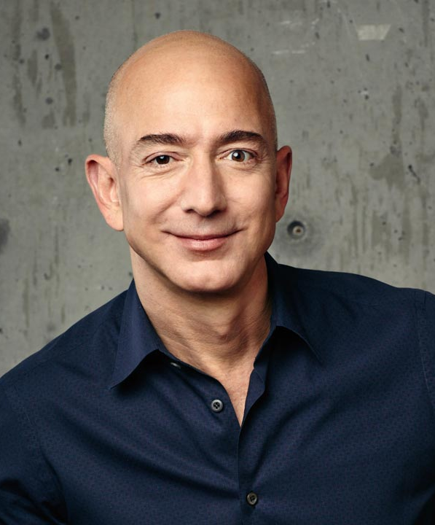
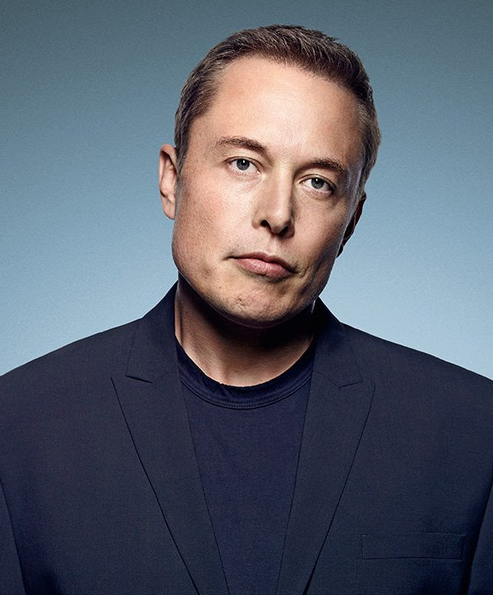
Transformational
Leadership Examples
Jeff Bezos
Elon Musk
Founder and Executive Chairman
of Amazon
Photo Credit: succeedfeed.com
CEO and Product Architect
of Tesla, Inc.
Photo Credit: businesstechafrica.co.za
Notes:
On this slide we have pictures of 2 pretty famous transformational leaders.
Both Jeff Bezos and Elon Musk have been branded as visionaries who have been revolutionary in rethinking their respective industries.
While many people point to the success of Amazon and Tesla there are some harsh critics of both Bezos and Musk in terms of their leadership style and the culture they have created at their companies.
These are really 2 great examples of the heights that transformational leadership can bring a company to, while also demonstrating some of the downsides that go along with the long-term implications of transformational leadership.

Slide 9
Authoritarian Leadership

Slide 10

Authoritarian
Leadership Overview
01.
02.
03.
The leader has clear goals
and objectives defined and expects others to follow.
Typically used when other team members do not have the skill or expertise needed.
This leader excels in time sensitive situations where there is no time to discuss things before making decisions.
Notes:
When you think of an authoritarian leader the first thing that comes to your mind might be a stern parent who tells you its their way or the highway, and honestly that is not far off for this kind of leader.
An authoritarian leader is one who clearly defines goals and objectives and expects every to follow their orders to achieve said goals. This kind of leader does well if they are on a team where no one else really has the skills or expertise needed to succeed and thus any benefits from discussing major decisions would be minimal. This kind of leader also excels in emergency or time sensitive situations where there is no time to discuss things before making big decisions, think about an emergency room doctor or a military commander in a battle, those are instances where a leader needs to provide direction and the team needs to act on it swiftly while trusting their leader.

Slide 11

Authoritarian Leadership
Pros and Cons
Pros
Cons
Time spent making large decisions
is streamlined.
Chain of command is clearly emphasized.
Consistent results.
A very strict leadership style can lead to high employee attrition or even rebellion.
Does not allow for a lot of innovation
or creativity.
Reduces collaboration and morale.
Notes:
In thinking about when an authoritarian leadership style is appropriate the pros and cons seem to make a lot of sense, and again while this style is much more strict this is not meant to condemn this style all together. When we’re talking through the pros and cons keep the imagine of the emergency room doctor in your head as this kind of leader, being solely responsible for making important decisions at a moments notice is an important skill for that job.
That leads us into our first pro that time spent making large decisions is reduced, this kind of leader doesn’t want to have multiple meetings to make important decisions and allows everyone more time to complete objectives by doing so.
Organizational hierarchy is very clear in this kind of leadership style, employees do not have to be confused about who they should talk with for direction, with this kind of leadership the buck always stops with them.
As the final pro results under this style of leadership are consistent, which again if we think of the ER doctor that’s a good thing but in other instances it could be a limiting factor.
Now let’s talk about the cons here the first of which is that this kind of strict leadership style can lead higher attrition and even employee rebellion. Its like having a really strict parent who imposes a lot of rules on you, often there is nothing you want more than to break their rules.
As you would expect this kind of leadership style does not exactly encourage creativity or innovation, in fact you could argue that creativity and innovation are punished under this leadership style.
Naturally as a consequence of the discouraged creativity and innovation you also see less group collaboration and lower morale because the employees feel as though they do not have a say and are not empowered to solve problems on their own.
We’ve been talking about situations where this kind of leadership style is appropriate, but what should be obvious is that outside of those areas this is generally not a good leadership style to employ.

Slide 12

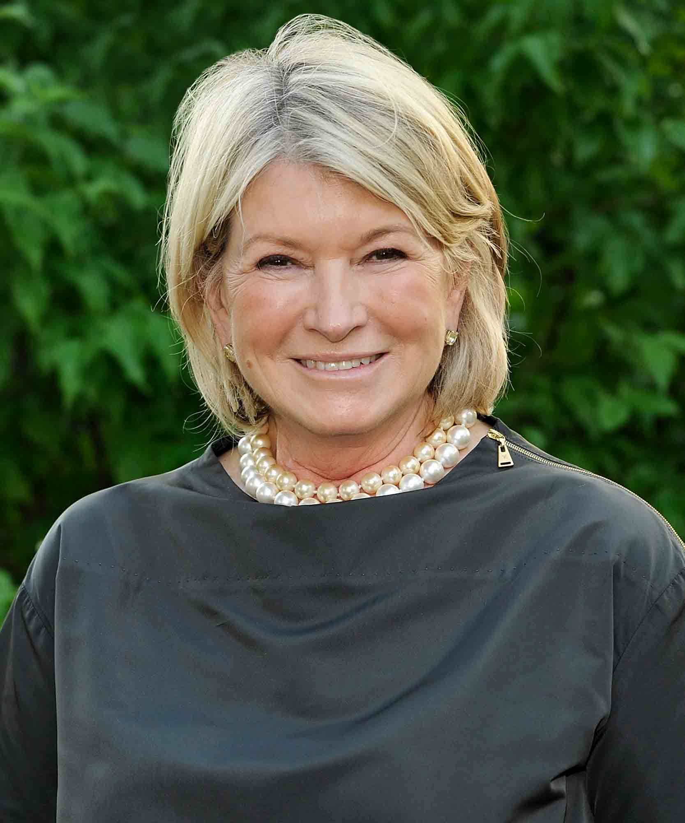
Authoritarian
Leadership Examples
Bill Gates
Martha Stewart
Co-founder of Microsoft
Photo Credit: melhorbroker.com
Businesswoman, writer,
television personality
Photo Credit: imagesvc.meredithcorp.io
Notes:
Here we have 2 examples you might not expect of authoritarian leaders in Bill Gates and Martha Stewart.
Bill Gates in the early days of Microsoft was infamously hard to work with and was unwilling to compromise on his vision for the company and technology as a whole. This lead some of his co founders leaving to start Apple or other ventures, but also allowed Microsoft to become the behemoth it is today.
And next we have Martha Stewart who is the first face many people picture when thinking about good housekeeping and insider trading. Martha started her business from the ground up and has a reputation for being very particular and demanding of her employees. While there are some who may disagree with her leadership style, and many who disagree with her investment style, you cannot deny that it was effective in building her brand and driving success.
Its worth noting that while both Bill Gates and Martha Stewart can be defined as authoritarian leaders, many will also cite examples of other leadership styles which the pair have been known to utilize. As we have been talking about, there really is no one size fits all style so taking inspiration from multiple styles is actually a smart move.

Slide 13
Servant
Leadership

Slide 14

Servant Leadership Overview
  Servant leaders are those who invert the traditional leadership model.
  Rather than the primary focus being on the company, its on your team.
  The team is the servant leader’s first priority in best serving the company.
  The idea is that by elevating the team, they will return that effort and elevate your organization.
Notes:
Next, we’re going to talk about servant leadership, which as a style is a pretty stark contrast from what we think of in terms of traditional leadership.
When we think about traditional leadership, we think of a manager who is really focused on having their team complete certain tasks, objectives, or to hit certain metrics. Their first priority is to improve the position of the company by providing their team with direction and holding a position of authority where they make all the key decisions.
Servant leadership on the other hand takes that idea and kind of puts it on its head. The goal behind servant leadership is that the manager’s first, and really sole, priority is to their team. To the point where they prioritize the needs of their people above the needs of the organization. How a manager can best serve their team is where this leadership style gets its name.
The ultimate aim of servant leadership is to be of service to your team which in turn is the best way to serve your organization because it enables your team to improve the company and hit key objectives.
Another key aspect of servant leadership is in when a manager shares some of their power with their team by letting subordinates take the lead on a project and take ownership of initiatives. This can be a difficult ask for some who has a more traditional mindset when it comes to leadership; whereby the equate power with responsibility and feel that they must be the one to complete certain tasks or solely make certain decisions. And therein lies the beauty of servant leadership, leaders that are able to let go and delegate more to their teams are actually in more control because of the relationships they have fostered with their team.

Slide 15

Servant Leadership
Pros and Cons
Pros
Cons
Increase employee loyalty and performance.
Add future leaders to the talent pipeline.
Improve employee decision making and development.
Employees are given autonomy and feel empowered.
The leaders can suffer burnout from regularly putting the needs of their team above their own needs.
Can be difficult to be more authoritative when the
need arises.
Success depends on employees who do well with autonomy and rise to the challenge.
Notes:
We’ve talked about how this kind of leadership style is more of a contrast to normal models of leadership, but the results really speak for themselves.
Servant leadership creates employees who are more loyal, higher performing, they feel engaged and empowered, and are more likely to seek leadership roles in the future which increases your talent pipeline. It’s a bit of a funny image but you can almost think of servant leadership like a pyramid scheme in that the goal is to create more servant leaders who will empower the next generation of workers to reach their own peaks or performance, while increasing performance, engagement, and loyalty in the process.
However, like we’ve been saying, there is not a one size fits all leadership style that is going to work for everyone, and servant leadership is no exception it also has drawbacks. The leaders themselves in particular can suffer burnout as a result of putting the needs of their team above their own so consistently.
This kind of leader can also have problems if they ever do need to conform to a more traditional leadership style at some point because their team will see it as such a stark contrast with how they lead regularly.
This last point is similar to transformational leadership in that both are somewhat dependent on leading employees who do well with a large degree of autonomy and are able to rise to the challenges that these kinds of leaders will present them.

Slide 16
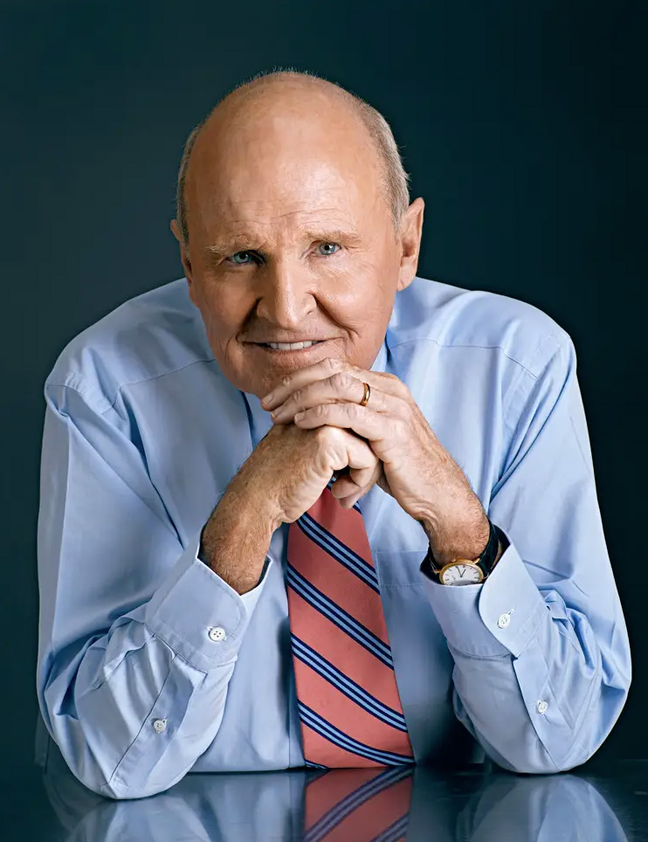
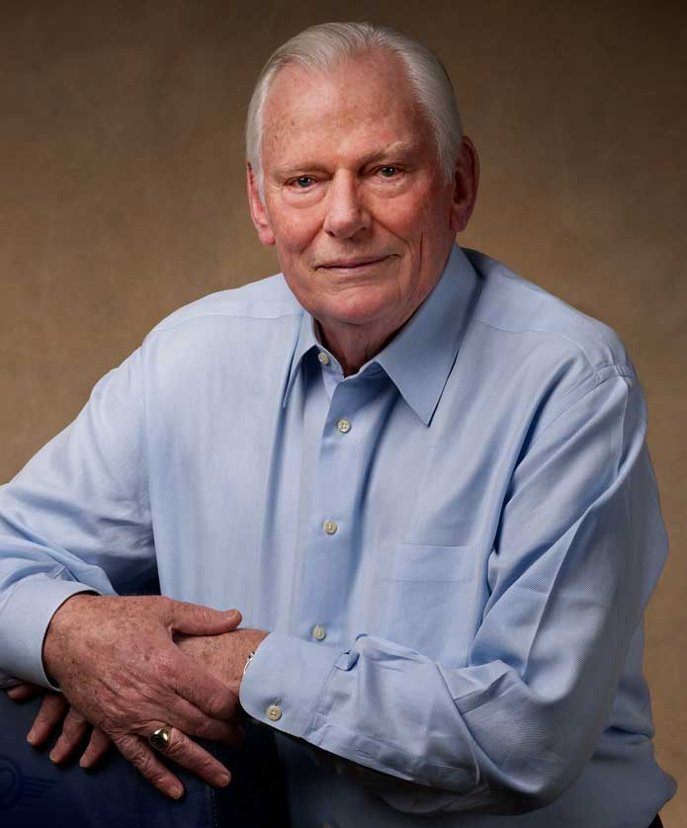
Servant Leadership Examples
Jack Welch
Herb Kelleher
Former CEO of General Electric
Photo Credit: i.insider.com
Former CEO of Southwest Airlines
Photo Credit: imagesvc.meredithcorp.io
Notes:
Here we’re seeing 2 noteworthy examples of servant leaders in Jack Welch and Herb Kelleher.
Jack Welch is the beloved former CEO of general electric who wrote “before you are a leader success is all about growing yourself. When you become a leader success is all about growing others.”
Herb Kelleher is the former CEO of southwest airlines and had a reputation for always putting his employees first. Herb in particular was famously good at remembering names and always took the time to get to know his employees, and he would love to tell a story about being on an elevator with the CEO of another company who didn't even acknowledge two employees who got on the elevator with them.
You would be hard pressed to think of better examples of servant leaders than the 2 on this slide, they really exemplify the core of servant leadership with their people first approach to management, and the results speak for themselves with the reputation both leaders enjoyed among their employees and the success that went along with it.

Slide 17
Democratic Leadership

Slide 18

Democratic
Leadership Overview
01.
02.
03.
The leader makes
decisions based on input from each team member.
While the final decision rests with the leader, each employee also gets an equal say.
One of the main goals in this style is to make their team feel their opinions and contributions matter.
Notes:
The next style we’re going to talk about is probably one of the more straightforward styles in the sense that it is exactly like it sounds.
A democratic ruler is someone who makes key decisions by getting input from every team member and giving their opinions serious weight.
While the final decision does rest with the leader, every employee gets a say, and this helps them to feel empowered and as is their opinions matter. The ultimate goal here is to make every employee invested in the team and to feel as though they have a say in the direction of the team or project, and that that level of empowerment will manifest itself in other ways later.

Slide 19

Democratic
Leadership Pros & Cons
Pros
Cons
Higher employee engagement and
workplace satisfaction.
Fosters collaboration, innovation,
and creativity.
Requires less managerial oversight.
Can be inefficient and costly as it lends itself to a longer decision-making process.
Can add social pressure to employees who may have dissenting opinions.
Notes:
When it comes to democratic leadership there are a lot of pros for employee development, but there can be cons when it comes to efficiency.
In an environment where every employee feels they have a voice, and by extension some level of control over their team or project, it can be easy to see why that would create higher engagement and workplace satisfaction. Additionally, this kind of
leader also creates a very open spaces for discussion of major decisions which leads to greater collaboration, innovation, and creativity than you might see under different styles of leadership.
And finally, since the major team decisions are so well discussed and delegated the leader does not have to get as involved because its very clear who is working on what.
As you might expect, one of the major drawbacks to this kind of collaborative team is that it can be inefficient in terms of taking more time and resources to reach decisions. This style is the exact opposite of an authoritarian leader who makes a decision by themselves, with a democratic leader teams are more engaged, but decisions take much longer to be reached.
Lastly one social dynamic that a leader has to be cognizant of is not creating an echo chamber. It can be great to have a team where everyone is able to discuss and weigh in on decisions, but it also has to be a space where people can safely voice dissenting opinions. If the leader is not careful to foster this kind of open and honest dialogue what can end up happening is that they end up with an environment where everyone just says yes to everything the leader suggests, and at the point it really ceases to be a truly democratic group.

Slide 20
Transactional Leadership

Slide 21

Transactional
Leadership Overview
01.
02.
03.
The transactional leader sets clear goals and outlines the rewards or consequences for not meeting them.
The give and take of this style is more concerned with results than with driving any changes.
Will be most effective in a sales type of environment.
Notes:
Transactional leadership is another style that is exactly what it sounds like, it is based on leading as if it were a transaction.
These leaders very clearly establish tasks that need to be done or set clear goals which need to be reached. They also lay out the particular incentives, or punishments, for meeting or not meeting these requirements.
This kind of leader is driven primarily by results and is not particularly concerned with challenging the status quo or inspiring any creative solutions.
The best example for this kind of leader is a sales manager who tell their sales staff that if they each sell 100 widgets by the end of the month they will receive a bonus, or if they fail to meet their regular sales goals they will be punished.

Slide 22

Transactional
Leadership Pros & Cons
Pros
Cons
Success is clearly defined and easily measured.
Employee motivation and productivity see an increase.
It is a system that is easy for leaders to implement
and monitor.
Employees very clearly know what is expected of them.
Innovation and creativity is minimized.
Employees often will not go above and beyond the minimum they need to do in order to get their reward.
Creates more followers than leaders.
Can be too focused on short term goals.
Notes:
Transactional leadership lends itself to the kinds of advantages and disadvantages that you might expect when keeping the example of a sales team in your head.
The pros of this style are that it is very easy for leaders to implement and monitor, and that success is clearly defined and easily measured for employees. If you know you need to sell 100 widgets by the end of the month to get your bonus, that is very clear for both the employee and manager in terms of expectations.
The rewards can also increase motivation and productivity by employees, when the requirements for a reward and much more clear and tangible its much easier for an employee to work toward them.
Now outside of a sales staff, and even in that context, this style is not without its drawbacks, the first of which is that innovation and creativity are minimized. This kind of leadership style often ends up with employees who will not go above and beyond what is required to either obtain the reward. This is a major drawback because if someone is incentivized to sell exactly 100 widgets, what incentive do they have to sell 200?
This style also tends to create employees who are great at their tasks, but at the cost of their professional development, the consequence is that this style is unlikely to create future leaders or add to the internal talent pipeline at all. Contrast that with servant leadership where a consequence of that style was that it constantly added to the internal talent pool, again not that one is better than the other universally but its just an interesting contrast to remember.
And finally this leadership style can often suffer from being too hyper focused on short term goals. If all the team cares about is selling 100 widgets per month, that is all they will ever do.

Slide 23
Delegative Leadership

Slide 24

Delegative
Leadership Overview
01.
02.
03.
Sometimes referred to as “laissez-faire leadership” or
hands-off leadership.
Emphasis on delegating initiatives to individual team members while providing minimal supervision.
Works best with highly experienced teams.
Notes:
Delegative leadership is, as you would expect, a leadership style based around delegation. It is also referred to as lassiez fair leadership or hands off leadership.
The emphasis here is that the leader delegates as much as possible and then provides minimal to no oversight to the employees who are accomplishing the tasks. These leaders will make themselves available for any support, but by and large they essentially assign a task and tell the employee to go do it and only reach out if they need something; trusting that they will be able to complete the project.
The logic behind this approach is that it works well on teams with highly experienced employees who do not need a manager with a lot of involvement, by getting out of their way and allowing them to complete initiatives it is actually the best way to manage them, so the argument goes.

Slide 25

Delegative
Leadership Pros & Cons
Pros
Cons
Relaxed environment which leads to higher retention rates.
Innovation and creativity are highly valued.
Those who value autonomy will have high
job satisfaction.
Creates a relaxed work environment.
Can be difficult to adapt to any
needed changes.
Not ideal for new employees.
Can lead employees to not feeling supported.
Roles and responsibilities can be unclear.
Notes:
Delegative leadership is a style that can be divisive for employees, generally they will either love it or hate it. Employees who are highly skilled and want the freedom to do things in the way they feel is best will love the autonomy that comes along with a delegative leader; they will also have very high job satisfaction and retention because of the relaxed environment.
However, those who like more traditional structure and need to feel more support and direction from their manager will hate a delegative leader. This is especially true for new employees, even senior employees who may have a strong grasp of their functional area but may not know the particular workings of the organization yet. These employees can feel like they are being thrown to the wolves with no one there to help them.
This leadership style can also lead to some roles and responsibilities being unclear, if the manager does not ever really give a lot of concrete structure it can be easy to see why there would be inconsistencies in the ways of working; which again is the other side of the sword to the high value placed on creativity and innovation.
Finally, this style especially can have a hard time adapting if the needs of the team or organization change such that it results in them having less freedom and needing to color in the lines more so to speak.

Slide 26
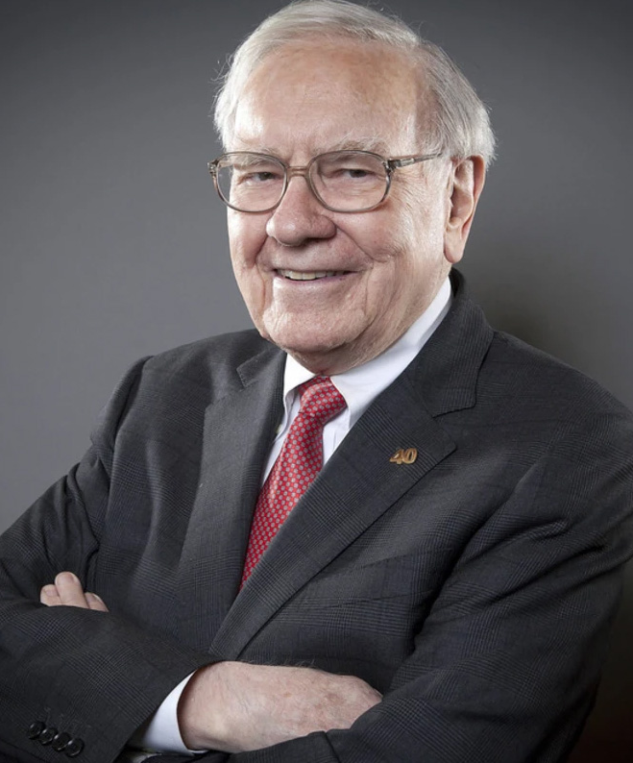
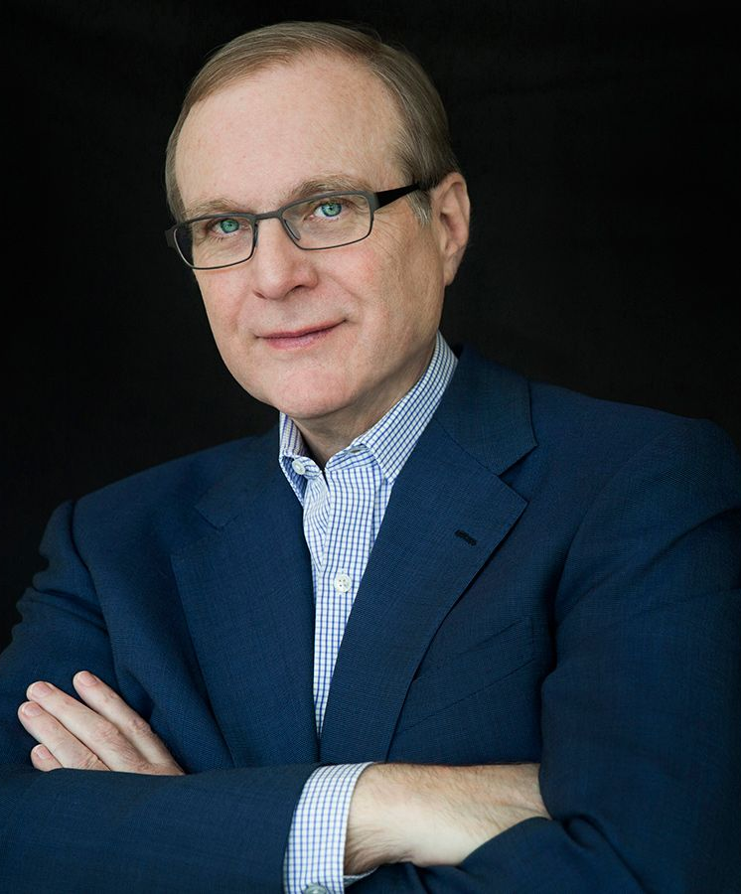
Delegative Leadership Examples
Warren Buffett
Paul Allen
Chairman and CEO
of Berkshire Hathaway
Photo Credit: media-cldnry.s-nbcnews.com
Co-founded Microsoft
Photo Credit: cdn.boatinternational.com
Notes:
Let's take a moment to examine two great examples of delegative leaders and dive into what that really looks like in practice
First, we have Warren Buffett who is most prominent for his investment firm Berkshire Hathaway which has large investments in some of the worlds most valuable brands including Coca Cola and Apple.
As a leader Buffett is someone who expects his employees to take responsibility for decisions and actions, he places more value on mentorship and education over task management. He also keeps business decisions in the hands of the companies he invests in, rather than trying to influence their decisions after investing. A shining example of the success that being a hands-off leader can bring in the right circumstances.
Next, we have Paul Allen a co founder of Microsoft who left in the 80s as it began to assume a more authoritarian management style. Paul went on to found an investment firm called Vulcan which invested in a number of various industries but most prominently he had majority stakes in a few sports teams including the Portland Trail Blazers and the Seattle Sea Hawks. Any sports fan can tell you that there is nothing worse than an owner who thinks he knows better than the coaches and makes a bunch of stupid decisions which end up hurting the team. Paul Allen was famous for the opposite of this, he very rarely interfered with choices made by coaches and instead bowed to their expertise. Another great example of delegative leadership wherein you hire people smarter than you in certain areas and then proceed to stay out of their way deferring to their expertise, after all it is the reason you hired them.

Slide 27
Pacesetting
Leadership

Slide 28

Pacesetting
Leadership Overview
01.
02.
03.
Leads by example and sets
the pace for high productivity
and performance.
Employees are meant to
follow this example.
Not afraid to jump into the trenches and help the team with any part of a project.
Notes:
A pacesetting leader is one who literally sets the pace and leads by example. They accomplish this by being a model of high productivity and performance and holding their team to the same standards.
These are the leaders who mantra would be “I would never ask you to do something I wouldn’t do myself” and they often demonstrate this by jumping in on projects when another set of hands are needed.
Similarly, if a team member is falling behind or not completing a task successfully this kind of leader will jump in and complete the task to make sure it is done right

Slide 29

Pacesetting Leadership
Pros and Cons
Pros
Cons
Efficient in terms of achieving goals on time.
Promotes high energy and dynamic
work environments.
Potential issues are noticed and dealt
with quickly.
Can lead to low morale, and high stress.
Emphasis on results can stifle creativity
and innovation.
Employees can feel as though their manager is constantly looking over their shoulder.
Notes:
When it comes to pacesetting leadership the results can be great, but the drawbacks can be equally bad in certain circumstances.
A thriving leader using this style is one who always has their team achieve their goals and notices any issues quickly because of how involved they are. This kind of leader thrives in a high energy fast paced type environment where they want to keep their pulse on everything and make sure all is running smoothly, and if its not running smoothly they can and will step in to make it happen.
However, this kind of hands-on management can come at the cost of employee morale and can lead to high stress on your team. Because this style is so results driven it can also stifle creativity and innovation, leaving employees thinking if they deviate even slightly from the example set by the leader that they will be quickly corrected.
Finally, it can be easy for employees to feel as though their manager is constantly looking over their shoulder being critical of their every move, which is what leads to the low morale and high stress. As a comparison, someone who would thrive under a delegative leader would absolutely hate this type of leader, but the opposite is also true. This is a leader who provides a lot of structure and knows very well what their team is doing every day, and some people or environments need that kind of a hands on leader.

Slide 30
Crafting Your
Own Style

Slide 31



Crafting Your Own Style
No one size fits all style for every team, organization, time, or employee.
Take bits and pieces from each style to make a style that works for you.
Be able to adjust your style to the needs of each of your employees.
Notes:
Now that we’ve talked about some of the most popular leadership styles and provided the pros and cons of each, I bet your trying to figure out which one is best for you or your organization.
As a reminder, there is no single style that will be the best fit for you or anyone else because there is so much variability in each of your organizations, teams, employees, and even where those things are at given points in time will change.
The best solution here is to take bits and pieces from each leadership style that you feel will work best for the kind of leader you want, or need, to be.
Perhaps you’re someone who wants to be more delegative and hands off generally, but you still want your team to feel supported, so you take some notes from servant leadership as well to ensure you don’t forget about their development.
Or perhaps you like the idea of being more hands off but want to bring some structure to that style so you borrow some ideas from a democratic style in assigning work but then leave everyone to their own devices once assignments have been given.
There are just so many possible iterations, only you are going to be able to determine what will work best for you and your employees.
The last and arguably most important thing to mention here is that you need to be adaptable. Even if you find what you feel is your perfect leadership style that does not mean that its going to be perfect for every employee on your team. Some employees might want you to be more hands off even if that’s outside your style, while others may want the opposite, they may want you to be more hands on even though that’s not generally what you do. As important as it is for you to find the style that works for you, you want to make sure that as much as possible you’re being the kind of leader that each person needs.

Slide 32
QUESTIONS?

Slide 33
Thank you
for your time.
Presented by: Drew Lewis (he/him/his)
Client Development Specialist

